Slide 1
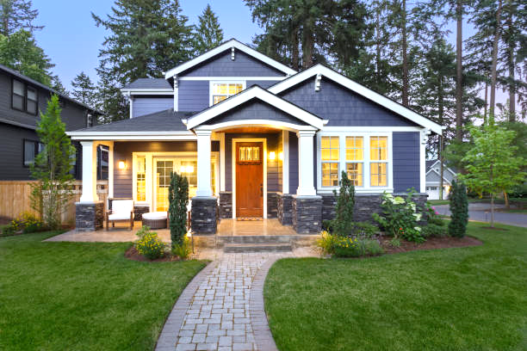
PROJECT 9:PREDICTING HOUSE PRICES USING MACHINE LEARNING
PROJECT TITLE : HOUSE PRICE PREDICTOR

Slide 2

Problem Definition
The housing market is an important and complex sector that impacts people's lives in many ways. For many individuals and families, buying a house is one of the biggest investments they will make in their lifetime. Therefore, it is essential to accurately predict the prices of houses so that buyers and sellers can make informed decisions. This project aims to use machine learning techniques to predict house prices based on various features such as location, square footage, number of bedrooms and bathrooms, and other relevant factors

Slide 3

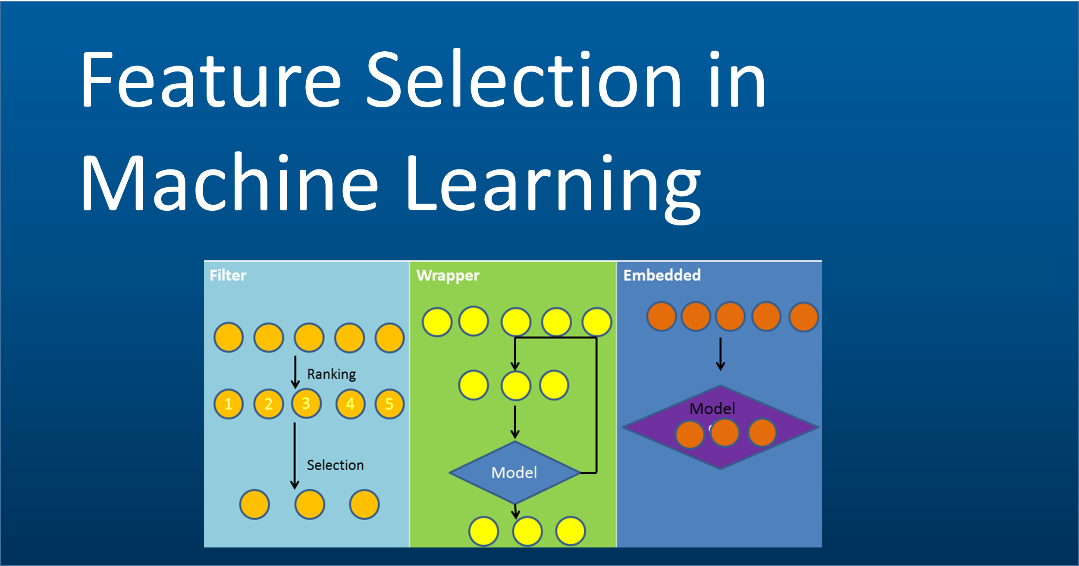

Data Source: Gather a dataset either from GitHub or it will be also available on Kaggle, that includes relevant features of houses such as location, number of rooms, square feet's, and sale prices. Ensure the dataset that has the features that you are about to consider.
Data Pre-processing: Clean and prepare the collected data for model training. Handle missing values, perform feature scaling to bring features to a similar range, encode categorical variables, and address outliers. Additionally, one can explore feature engineering techniques to create new meaningful features.
Feature Selection: It comprises a majority portion of the dataset and is used to teach the model the patterns and relationships between the input features (e.g., number of rooms, location, square footage) and the target variable (i.e., house prices). The model learns from the training set to make predictions.
Model Selection: Choose a suitable machine learning algorithm for house price prediction, considering factors such as the dataset size, feature complexity, and interpretability requirements. Common algorithms include linear regression, decision trees, random forests, or more advanced techniques. We trained and tested five algorithms and finally XGBoost is performing better.
Model Training: In this phase, various machine learning algorithms are applied to train a predictive model using the pre-processed data. Common approaches include linear regression, decision trees, random forests, or more advanced techniques like gradient boosting or neural networks.
Evaluation: The evaluation process involves fitting the model to the training data, optimizing hyper parameters, and evaluating the model's performance using appropriate metrics such as mean squared error or R-squared.
Design Thinking

Slide 4
Input: The input section represents the initial stage of the house price prediction process. Here, one has to gather relevant data that could influence house prices, it can be the dataset. This data may include factors such as the size of the house, number of bedrooms, location, neighbourhood amenities, historical sales data, and other relevant features.
Pre-processing: In the pre-processing stage, the collected data goes through various cleaning and transformation steps to ensure its quality and suitability for analysis. This involves tasks like handling missing values, removing outliers, normalizing or scaling the data, and encoding categorical variables. Pre-processing helps to prepare the data for effective modelling
Model: The model section represents the core of the house price prediction process. Here, one has to select an appropriate machine learning algorithm or ensemble of algorithms to build a predictive model. Commonly used algorithms for house price prediction include linear regression, decision trees, random forests, support vector machines, or neural networks. The model takes the preprocessed data as input and learns patterns and relationships within the data to make predictions on house prices.
Ensembling: Ensemble refers to the practice of combining multiple predictive models to improve the accuracy and robustness of the predictions. In this stage, one has to employ techniques such as averaging, bagging, boosting, or stacking to create an ensemble model. By leveraging the strengths of different models, ensemble aims to achieve more accurate and reliable predictions by reducing bias and variance.
Output: The output section represents the final stage of the house price prediction process. Here, the trained model or ensemble provides predictions on house prices based on the given input data. The predictions can be in the form of specific price values or in percentage.
Project Roadmap

Slide 5

Here’s a simple example in Python using scikit-learn and a Linear Regression model
```
Import pandas as pd
From sklearn.model_selection import train_test_split
From sklearn.linear_model import LinearRegression
From sklearn.metrics import mean_squared_error
# Load the dataset
Data = pd.read_csv(‘house_data.csv’)
# Split the data into features (X) and target (y)
X = data.drop(‘SalePrice’, axis=1)
Y = data[‘SalePrice’]
# Split the data into training and testing sets
X_train,X_test, y_train, y_test = train_test_split(X, y, test_size=0.2, random_state=42)
# Create and train the model
Model = LinearRegression()
Model.fit(X_train, y_train)
# Make predictions
Y_pred = model.predict(X_test)
# Evaluate the model
Mse = mean_squared_error(y_test, y_pred)
Rmse = np.sqrt(mse)
Print(f’Root Mean Squared Error: {rmse}’)
```

